Slide 1
Analyzing Global Suicide Trends (1985 to 2016)
Arvin Rene Caabay
April 2024

Slide 2
Background
As per the World Health Organization, an estimated 703,000 people a year take their life around the world.
And for every suicide, there are likely 20 other people making a suicide attempt and many more have serious thoughts of suicide.
Suicide is a complex phenomenon with profound implications worldwide
Global suicide trends provides valuable insights for making informed decisions for suicide prevention efforts and policy development.

Slide 3
Objectives
Explore the correlation between GDP per capita and suicide rates to ascertain whether nations with higher GDP per capita exhibit lower suicide rates;
Assess the impact of age and gender on suicide rates across diverse countries;
Assess the impact of gender on suicide rates across diverse countries.

Slide 4
Methodology
Data Loading and Inspection
Import necessary libraries
Load the dataset using
Check the shape of the dataset
Inspect the first rows of the dataset
Items Formatting / Cleaning
Improve column titles
Remove the "HDI for year" column due to mostly incomplete data.
Remove the "country-year" column as it is redundant.
Change the data type of the "gdp_for_year ($)" column from object to numeric.
Correct invalid country names using the pycountry library.
Years 1985-1994 and 2015-2016 were excluded from the analysis due to significant data gaps.
Certain countries were also omitted from the dataset due to incomplete. Multiple Data is still unavailable even after cross-referencing with authoritative sources such as the World Health Organization (WHO).
Morality Clause invoked to not make up or guess missing data for No. of Deaths.
Exploratory Data Analysis (EDA)
Explore the distribution of suicide rates across different countries, years, sexes, and age groups.

Slide 5
Methodology
Data Visualization
Visualize correlations between numerical columns using a heatmap
Plot a map chart showing average suicide rates per country.
Perform linear regression analysis between GDP per capita and suicide rates.
Visualize the relationship between GDP per capita and suicide rates using a scatter plot.
Standardize the data of GDP per capita and suicide rates and visualize the correlation matrix.
Correlation Analysis
Calculate correlation coefficients between GDP per capita and suicide rates per country.
Investigate correlations between GDP per capita and suicide rates across different age groups.
Gender Comparison
Compare suicide rates between genders using a T-test.
Visualize the distribution of suicide rates by gender using histograms.
Compare mean suicide rates between genders using a bar plot.

Slide 6
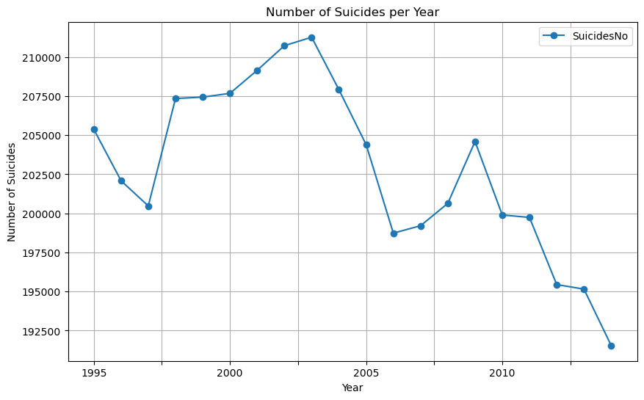
Data Visualizations

Slide 7
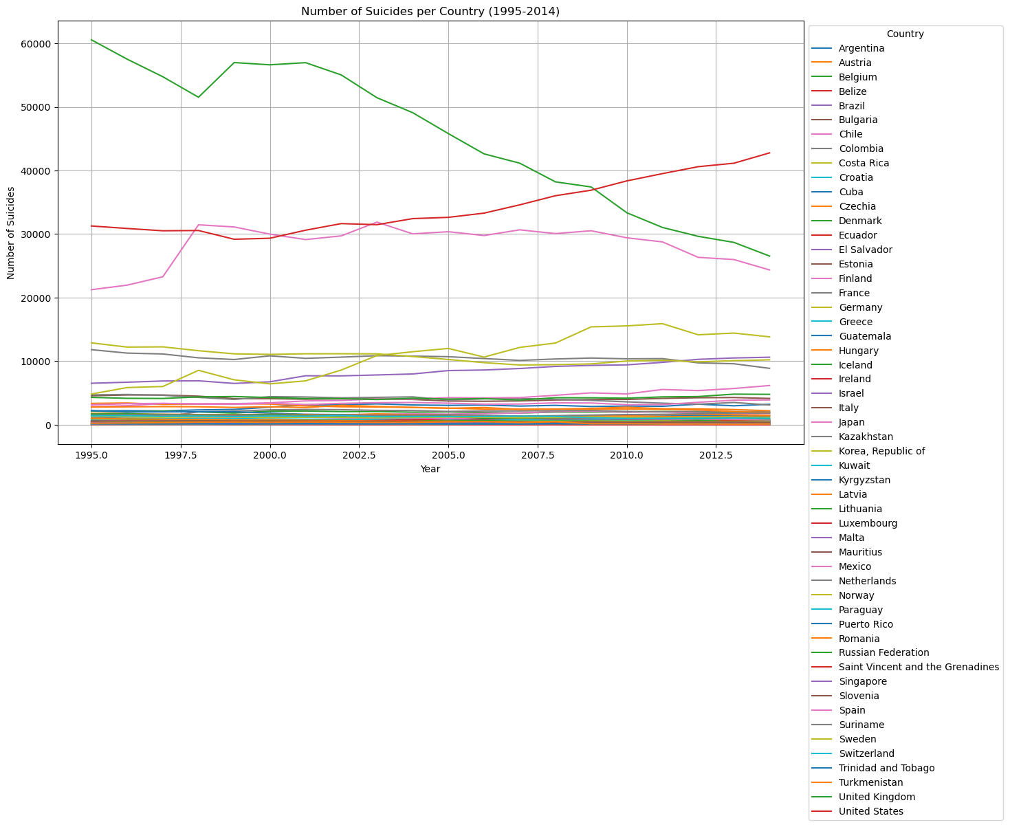
Data Visualizations

Slide 8
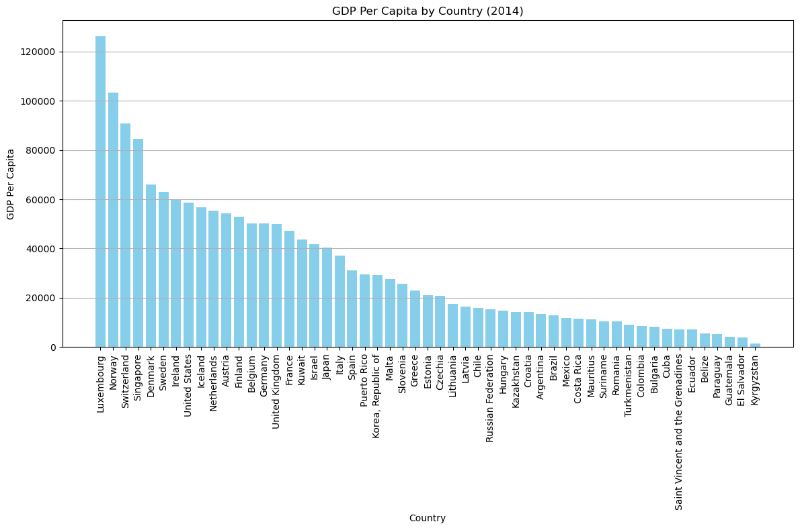
Data Visualizations

Slide 9
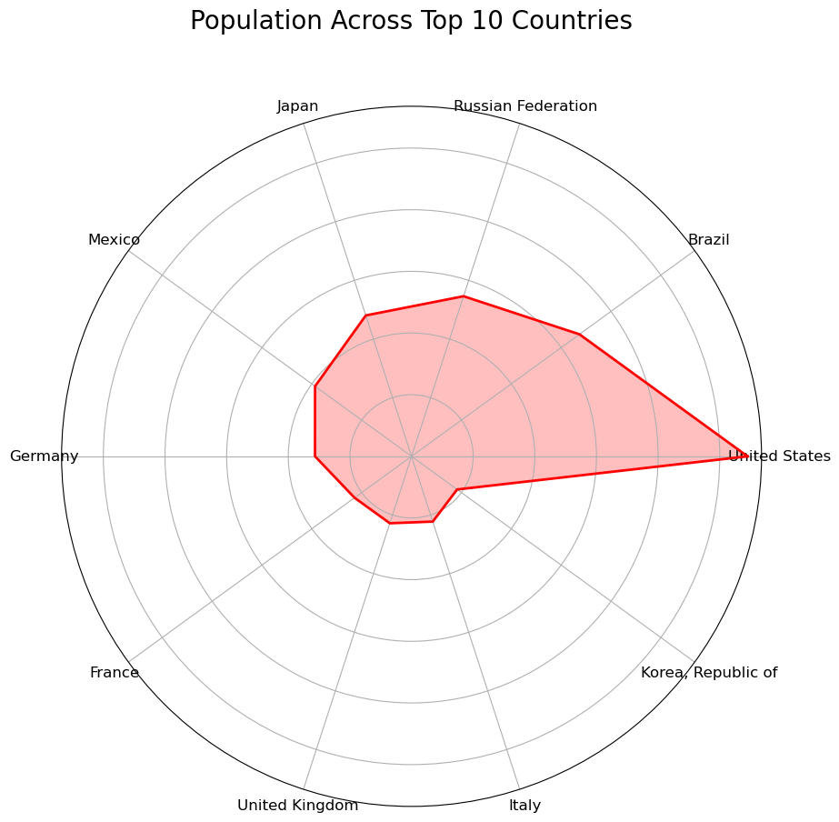
Data Visualizations

Slide 10
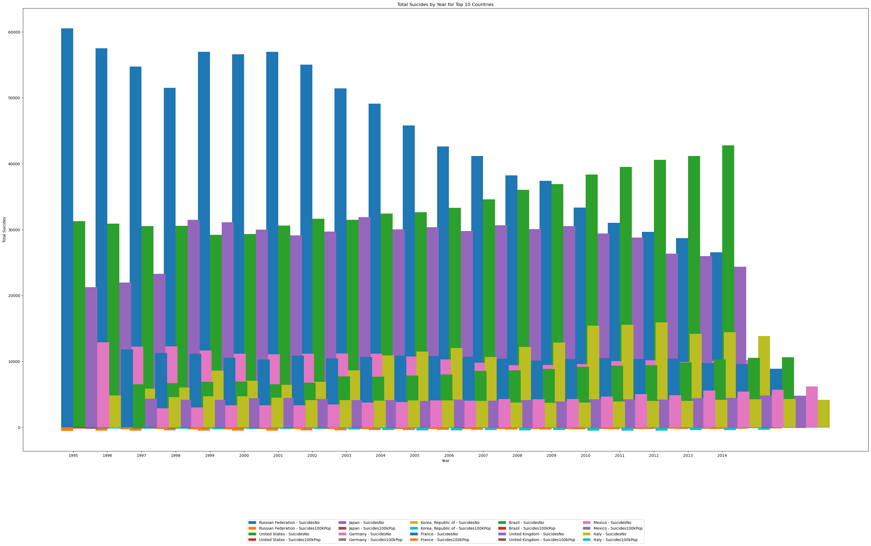
Data Visualizations

Slide 11
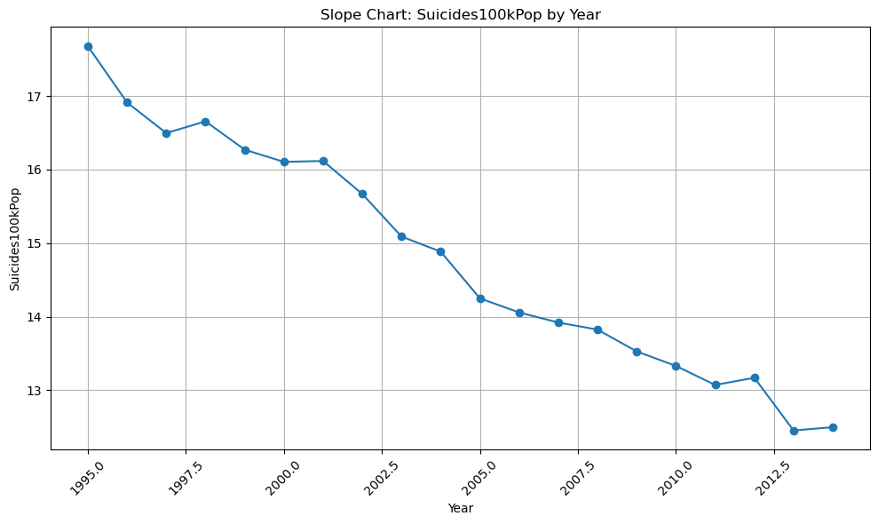
Data Visualizations

Slide 12
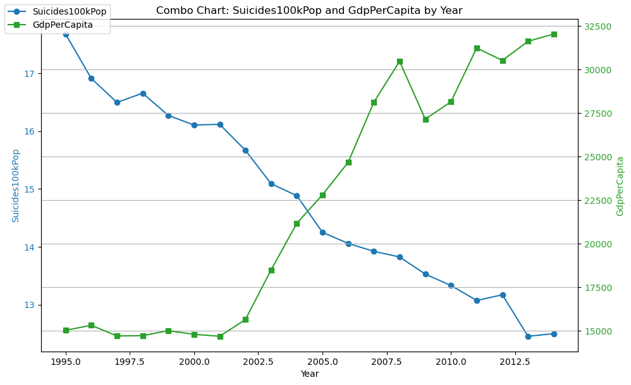
Data Visualizations

Slide 13
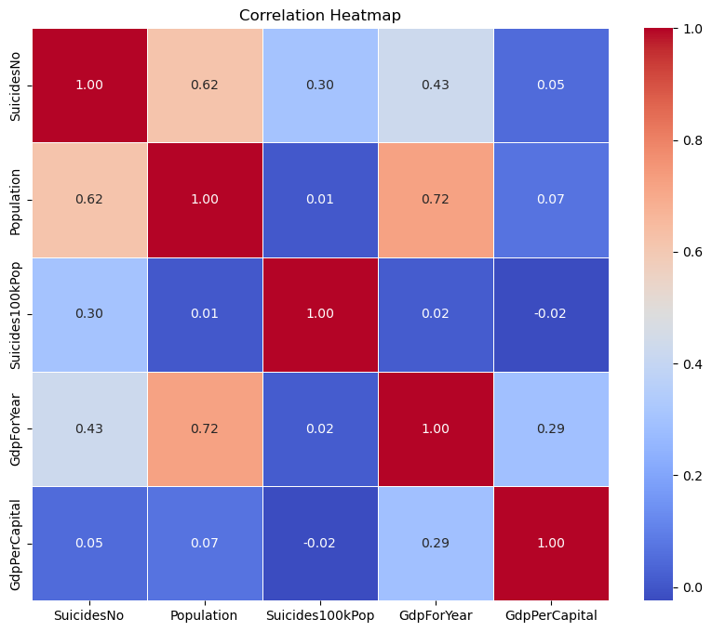
Data Visualizations

Slide 14
Insights
Add your first bullet point here
Add your second bullet point here
Add your third bullet point here

Slide 15
Insights
Add your first bullet point here
Add your second bullet point here
Add your third bullet point here

Slide 16
Insights
Add your first bullet point here
Add your second bullet point here
Add your third bullet point here

Slide 17
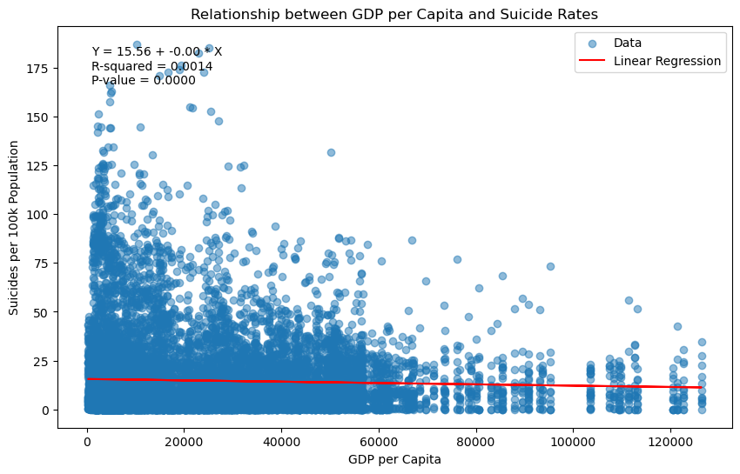
Insights
GDP per capita vs. Suicide Rate per 100k Population

Slide 18
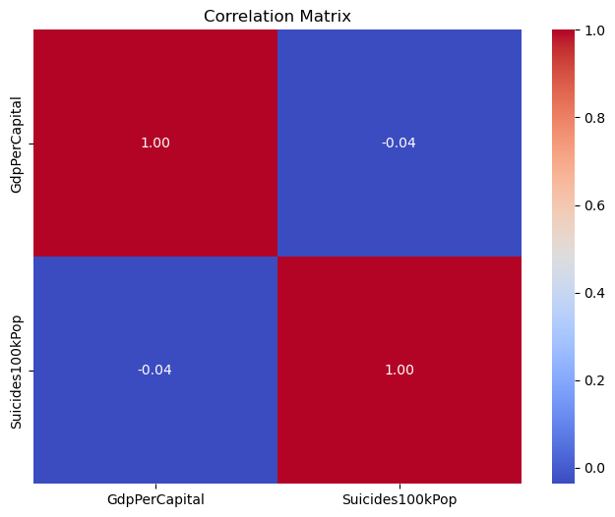
Insights
GDP per capita vs. Suicide Rate per 100k Population
The linear regression analysis indicates a weak negative relationship between GDP per capita and suicide rate per 100k population, with a negative slope and low R-squared value.
The correlation coefficient between GDP per capita and suicide rate per 100k population is also very low (-0.036751), suggesting a weak inverse relationship.

Slide 19
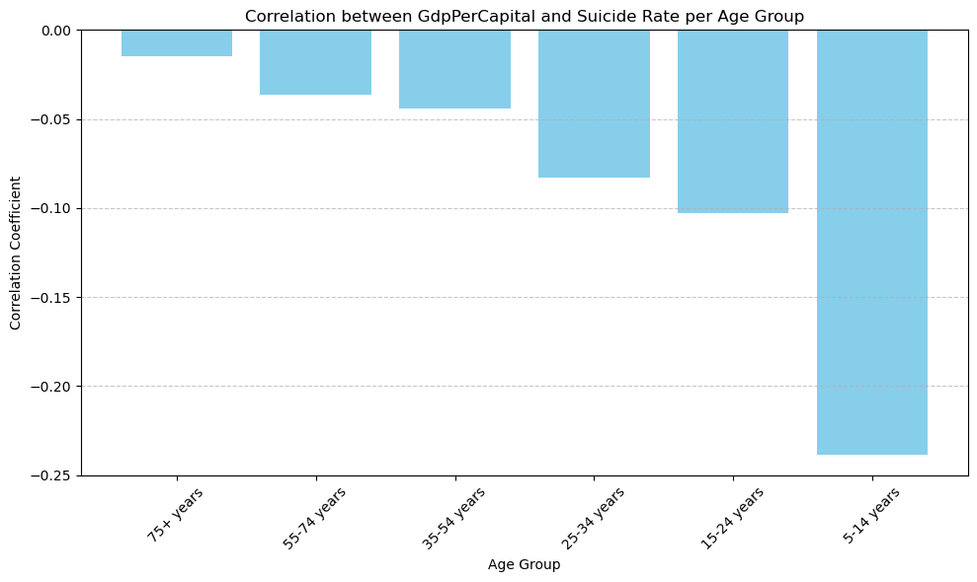
Insights
GDP per Capital per Age Group
There is a negative correlation between GDP per capita and suicide rate across different age groups, with stronger negative correlations observed among younger age groups. This suggests that nations with higher GDP per capita tend to have lower suicide rates across all age groups, with the strongest effect observed in the 5-14 years age group.
But in its entirety, the correlation is irrelevant.

Slide 20
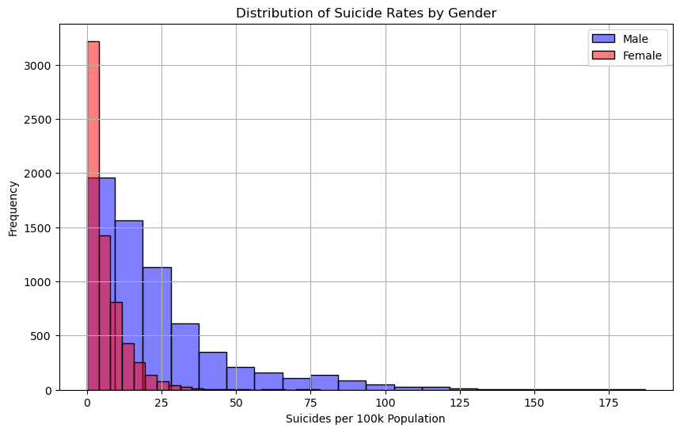
Insights
Suicide Rate Based on Gender

Slide 21
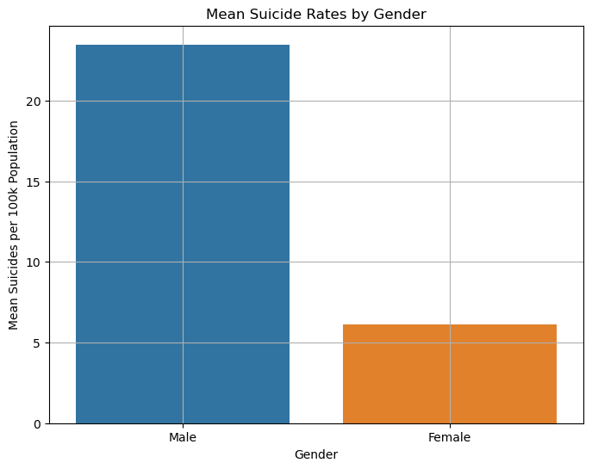
Insights
Suicide Rate Based on Gender
The analysis shows that males have a significantly higher suicide rate compared to females, as indicated by the total suicides per 100k population.
The T-test results confirm that the difference in suicide rates between genders is statistically significant, with a very low p-value.

Slide 22
Recommendations
While the analysis indicates a weak relationship between GDP per capita and suicide rates, it's essential to address underlying socioeconomic factors that may contribute to suicide risk. Policies aimed at improving economic opportunities, reducing income inequality, and providing social support systems could help mitigate suicide risk.
Given the stronger negative correlation between GDP per capita and suicide rates among younger age groups, targeted interventions focusing on mental health support, education, and social inclusion for adolescents and young adults may be beneficial.
Develop gender-specific suicide prevention strategies that address the unique risk factors and challenges faced by males and females. This could involve promoting mental health awareness, improving access to support services, and challenging societal norms related to masculinity and help-seeking behavior.
Continued Research and Monitoring: Further research is needed to better understand the complex interplay between socioeconomic factors, mental health, and suicide risk. Continual monitoring of suicide trends and risk factors can inform evidence-based interventions and policy decisions aimed at reducing suicide rates.

Slide 23
Reflections
Challenges Encountered
One of the primary challenges was dealing with incomplete or missing data. This required careful consideration when cleaning the dataset and making decisions about which data points to include in the analysis.
Understanding the limitations of correlation analysis was challenging. While correlations provide insights into relationships between variables, they do not imply causation.
Lessons Learned
Data Preparation is always Key!
Visualizing data using various techniques such as heatmaps, scatter plots, and histograms proved invaluable in uncovering patterns and relationships within the data.
Opportunities for Future Research:
Update the Paper once complete data is available
Longitudinal Analysis
Recommendations for Policy Evaluation

Slide 24
Conclusions
The statistical analysis revealed a weak negative relationship between GDP per capita and suicide rates. While the correlation was low and the R-squared value indicated limited explanatory power, the negative slope suggests that nations with higher GDP per capita tend to have slightly lower suicide rates.
Across different age groups, there was a negative correlation between GDP per capita and suicide rates, with stronger negative correlations observed among younger age groups. This indicates that nations with higher GDP per capita may have lower suicide rates across all age groups, particularly among adolescents and young adults.
Gender-based analysis revealed significant disparities in suicide rates, with males exhibiting significantly higher rates compared to females. This finding underscores the importance of gender-specific approaches in suicide prevention efforts and highlights the need for targeted interventions addressing the unique risk factors faced by males.

Slide 25
Citations
https://www.kaggle.com/datasets/russellyates88/suicide-rates-overview-1985-to-2016
https://www.kaggle.com/code/szamil/suicide-in-the-twenty-first-century/notebook
https://databank.worldbank.org/source/world-development-indicators
https://hdr.undp.org/data-center/country-insights#/ranks
https://www.who.int/campaigns/world-suicide-prevention-day/2022
https://crisis-clinic.org/suicide/
https://healthygrandcounty.org/resource-directory/2122/suicide-prevention-resources/

Slide 26


Thank You!

